Slide 1
BIG DATA SECURITY
Dealing with the evolution of Hadoop’s Security Model
MITALEE PATANGE
ITMS528

Slide 2
OVERVIEW
Big Data
Security Challenges with Big Data
Hadoop Architecture – what makes it vulnerable?
Why traditional systems fall short?
Latest solutions available
Case studies
Best Practices and Recommendations

Slide 3
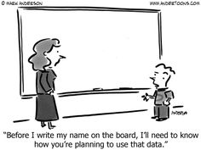
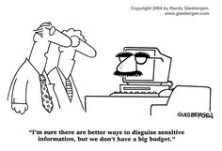
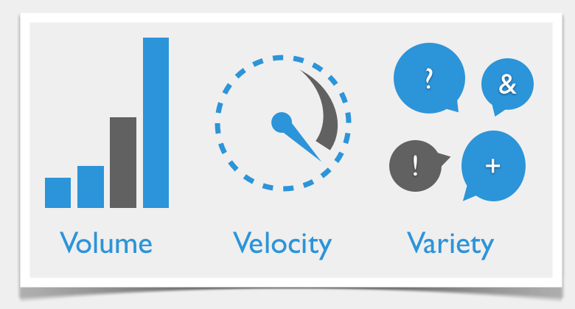
BIG DATA
3Vs
Big Data Analytics
Tools, Trends & Best Practices
Notes:
The three Vs are not sufficient to explain Big Data.
Volume - 90% of all data ever created, was created in the past 2 years
Velocity - Every minute we upload100 hours of video on YouTube.
Variety - Data today comes in many different formats: structured data, semi-structured data, unstructured data and even complex structured data.
4 extra V's are required:
Veracity - able to trust that data , Variability- in meaning to understand context,
Visualization- comprehensive presentable format and Value - value is in the analyses done on raw data.

Slide 4
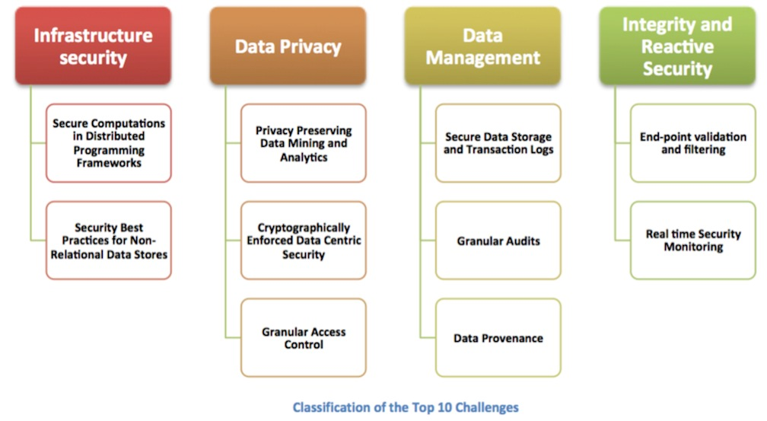
SECURITY CHALLENGES WITH BIG DATA

Slide 5
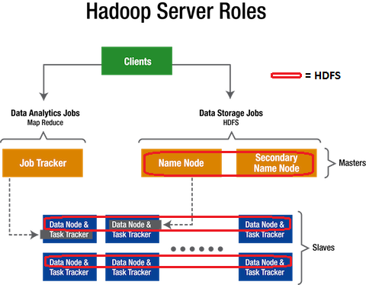
HADOOP ARCHITECTURE

Slide 6
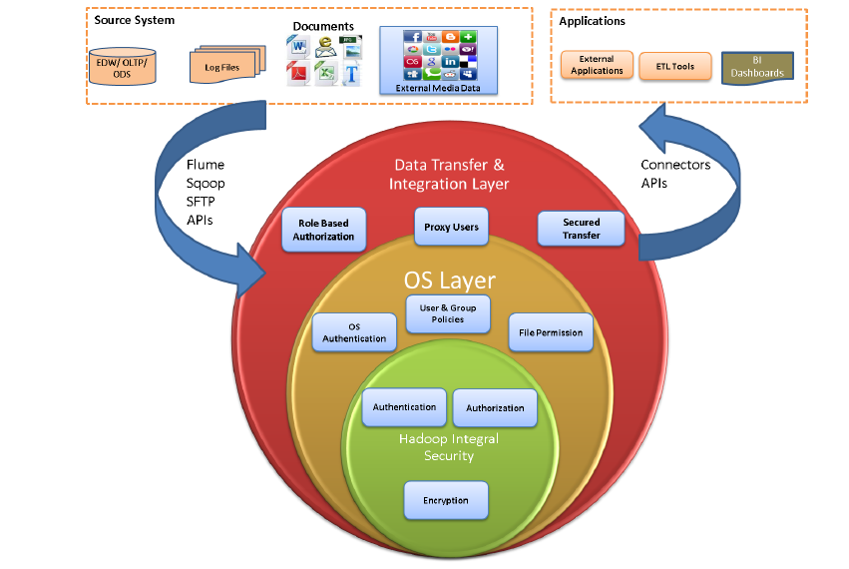
THREE TIER SECURITY APPROACH
Data Transfer & Integration
Flume
Sqoop
External tools
File transfer
OS
Authentication & Authorization
Hadoop integral security
Authentication
Authorization
Encryption
Notes:
Three reasons to secure data on hadoop :
1. Sensitive , 2. Regulatory adherence and 3. Enabler to business

Slide 7
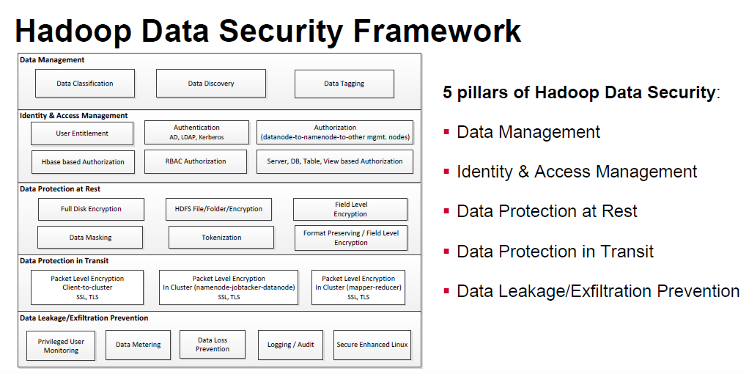

Slide 8
WHY TRADITIONAL SYSTEMS FALL SHORT?
Distributed Computing
Fragmented Data
Access to data
Node-to-node communication
Virtually no security

Slide 9
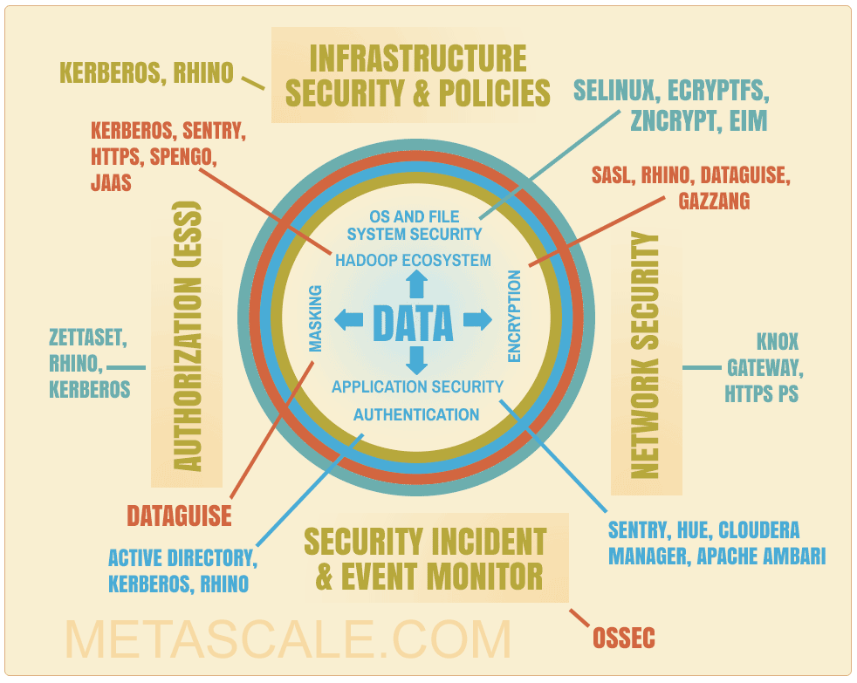
LATEST SOLUTIONS IN MARKET
OPEN SOURCE
Cloudera Sentry
Knox Gateway
Intel’s project Rhino
COMMERCIAL
DataGuise
IBM’s Infosphere
Zettaset Orchestrator
Protregity Data Protector

Slide 10
CASE STUDIES
Netflix
Differential Privacy
De-anonymization algorithm
Health Care Analytics
Inaccurate health care charges, medication
Mobile phone logging data
Encrypt and mask specific sensitive data

Slide 11

BEST PRACTICES AND SECURITY RECOMMENDATIONS
Authentication
Authorization
Network Encryption
Data protection

Slide 12


